Slide 1
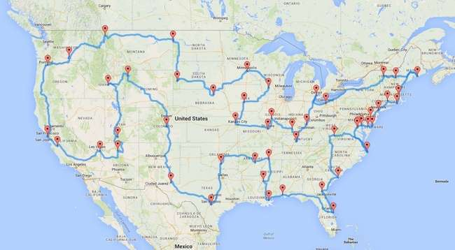

USA ROAD TRIP PLANNER & ALGORITHM EVALUATION
CPT204 Coursework 3 —
USA Road Trip Planner & Algorithm Evaluation

Slide 2

CONTENTS
PROJECT INTRODUCTION
PROGRAM DESIGN
GRAPH ALGORITHM
VISUALIZATION
SORTING ALGORITHM
REFLECTION & FUTURE WORKS

Slide 3
PROJECT INTRODUCTION
Group 1

Slide 4

This project implements a USA Route Planner based on Java and JavaFX, integrating graph algorithms with a user-friendly visualization interface.
Users can plan optimal travel routes between cities, optionally including scenic attractions. The system supports multiple pathfinding algorithms (DFS and Dijkstra), modular architecture, and real-time graphical feedback.
It emphasizes algorithm efficiency, object-oriented design, and a smooth user experience across varied input conditions.
PROJECT INTRODUCTION

Slide 5
PROGRAM DESIGN
Group 1

Slide 6
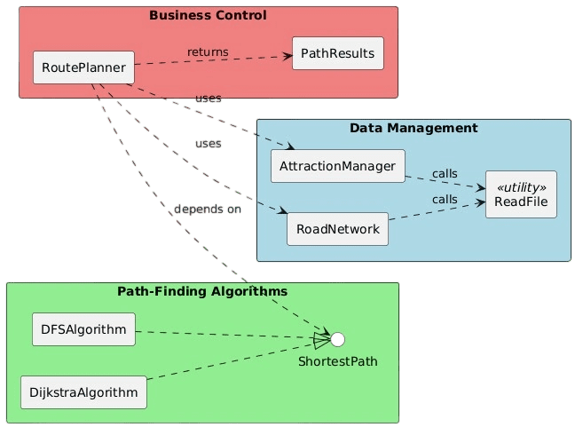
System overview & Architecture
3 layers: Data process, Algorithm, Business control
Core: RoutePlanner schedules planning
Supports modularity & extension
PROGRAM DESIGN

Slide 7
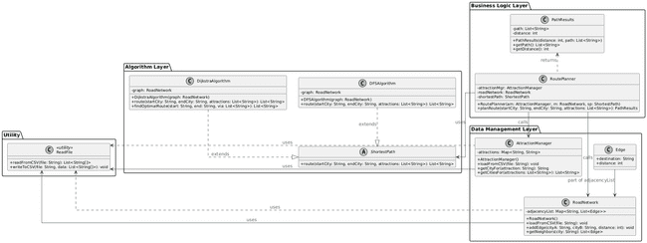
Data structure & Class design
DATA STRUCTURE:
HashMap for attractions.csv: fast lookup
Adjacency list for roads.csv: space-saving (Based on sparse graphs)
CLASS DESIGN:
PROGRAM DESIGN

Slide 8

OOP Principles
Benefit: → Prevents data from unauthorized changes → Ensures a stable interface for use
Encapsulation
AttractionManager (private Map + getter)
RoadNetwork (private adjacency list)
PathResults (final fields + get methods)
Inheritance
ShortestPath abstract class
DijkstraAlgorithm, DFSAlgorithm inherit it
Polymorphism
RoutePlanner holds ShortestPath reference
Calls .route() without knowing actual algorithm
Abstraction
ShortestPath defines route() method
Subclasses implement it with specific logic
PROGRAM DESIGN

Slide 9
OOP Principles
Benefit: → Easy to add new path-finding algorithms → Code reuse (e.g., shared logic in Dijkstra)
Encapsulation
AttractionManager (private Map + getter)
RoadNetwork (private adjacency list)
PathResults (final fields + get methods)
Inheritance
ShortestPath abstract class
DijkstraAlgorithm, DFSAlgorithm inherit it
Polymorphism
RoutePlanner holds ShortestPath reference
Calls .route() without knowing actual algorithm
Abstraction
ShortestPath defines route() method
Subclasses implement it with specific logic
PROGRAM DESIGN

Slide 10
OOP Principles
Encapsulation
AttractionManager (private Map + getter)
RoadNetwork (private adjacency list)
PathResults (final fields + get methods)
Inheritance
ShortestPath abstract class
DijkstraAlgorithm, DFSAlgorithm inherit it
Benefit: → Supports runtime flexibility → Algorithm can be swapped dynamically → Cleaner & more modular logic
Polymorphism
RoutePlanner holds ShortestPath reference
Calls .route() without knowing actual algorithm
Abstraction
ShortestPath defines route() method
Subclasses implement it with specific logic
PROGRAM DESIGN

Slide 11
OOP Principles
Encapsulation
AttractionManager (private Map + getter)
RoadNetwork (private adjacency list)
PathResults (final fields + get methods)
Inheritance
ShortestPath abstract class
DijkstraAlgorithm, DFSAlgorithm inherit it
Benefit: → Enforces consistent interface → Developers only need to extend base class → Easier team collaboration & maintenance
Polymorphism
RoutePlanner holds ShortestPath reference
Calls .route() without knowing actual algorithm
Abstraction
ShortestPath defines route() method
Subclasses implement it with specific logic
PROGRAM DESIGN

Slide 12
GRAPH ALGORITHM
Group 1

Slide 13
Graph algorithm design
Problem overview
Input: start city, end city, attractions (option)
Goal: Find the shortest path
Starts at the start city
Ends at the end city
Visits all attractions
Graph Abstraction
Cities = nodes
Roads = edges (with distances)
Algorithm Strategy
Use different algorithms based on attraction count:
DFS: for small interests A
State-compressed Dijkstra: for large interests A
GRAPH ALGORITHM

Slide 14
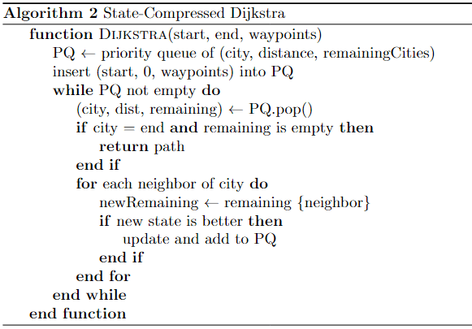
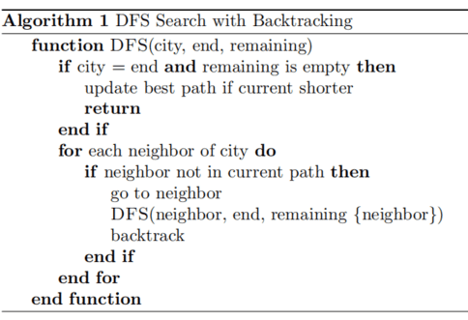
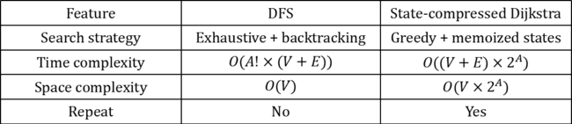
Algorithm overview
Feature | DFS | State-compressed Dijkstra
Search strategy | Exhaustive + backtracking | Greedy + memoized states
Time complexity | $$O(A!×(V+E))$$ | $$O((V+E)×2^{A})$$
Space complexity | $$O(V)$$ | $$O(V×2^{A})$$
Repeat | No | Yes
GRAPH ALGORITHM

Slide 15
VISUALIZATION
Group 1

Slide 16
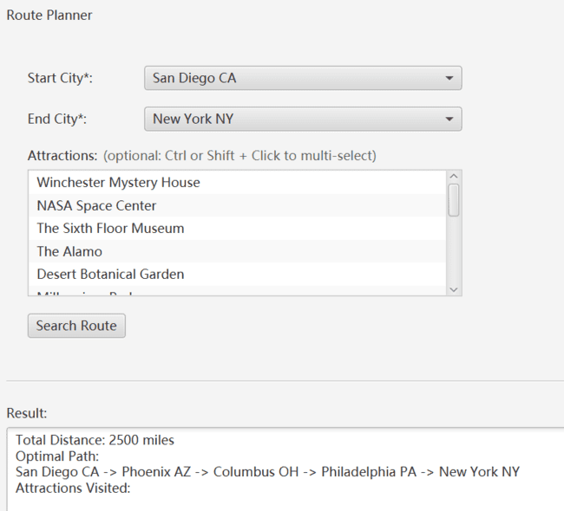
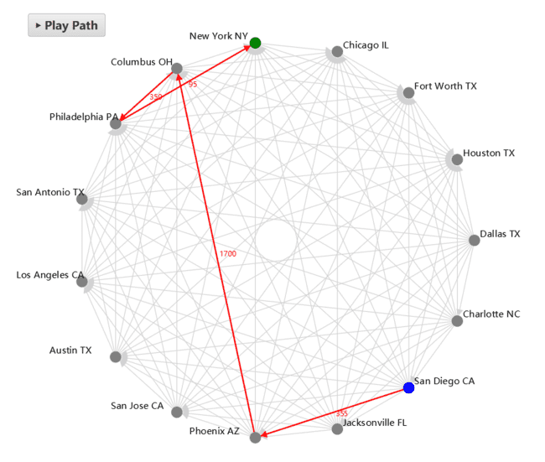
Basic visualization implementation
Situation One:
The user did not enter the attraction.
VISUALIZATION

Slide 17
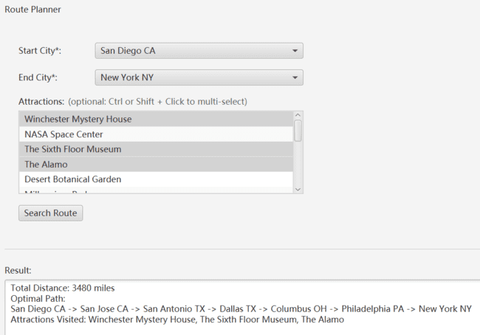
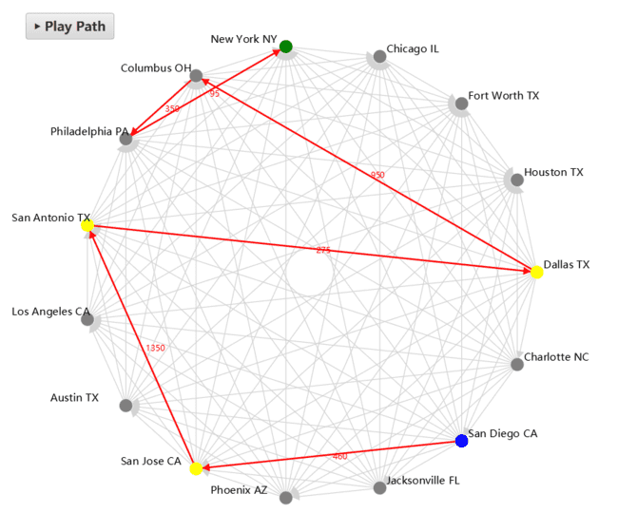
Basic visualization implementation
Situation Two:
The user selects multiple attractions.
VISUALIZATION

Slide 18

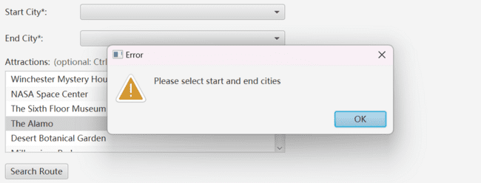
Basic visualization implementation
Situation Three (error situation handling):
The user did not enter the starting point or the ending point.
VISUALIZATION

Slide 19
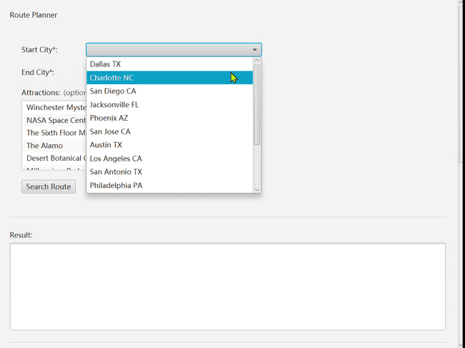
Visual interaction
Path animation playback.
Hover the mouse over the city and the corresponding scenic spots will be displayed.
Drag the map with the mouse.
The scroll wheel controls zooming.
VISUALIZATION

Slide 20
SORTING ALGORITHM
Group 1
Notes:
Let’s look at the Task C sorting algorithm

Slide 21
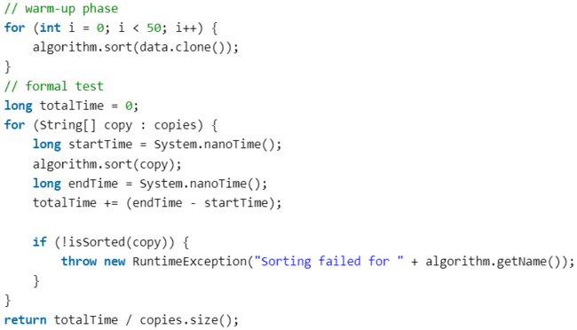
Benchmark Overview
Datasets
1000places_sorted.csv
1000places_random.csv
10000places_sorted.csv
10000places_random.csv
Sorting algorithm:
Insertion sort
Quick sort
Merge sort
SORTING ALGORITHM
Notes:
In this section, we evaluate the performance of three sorting algorithms: Insertion Sort, Quick Sort, and Merge Sort.
The test datasets include 1000 and 10000 items, both sorted and randomly ordered.
The goal is to understand how input size and order affect sorting efficiency.

Slide 22
Benchmark Overview
Datasets
1000places_sorted.csv
1000places_random.csv
10000places_sorted.csv
10000places_random.csv
Sorting algorithm:
Insertion sort
Quick sort
Merge sort
Test method:
Warm-up process
SORTING ALGORITHM
Notes:
To improve the accuracy of the measurement time, we first conducted a warm-up process.

Slide 23
Benchmark Overview
Datasets
1000places_sorted.csv
1000places_random.csv
10000places_sorted.csv
10000places_random.csv
Sorting algorithm:
Insertion sort
Quick sort
Merge sort
Test method:
Warm-up process
Average value
SORTING ALGORITHM
Notes:
For each algorithm, we ran 50 repetitions per dataset, measured the average time using System.nanoTime(), and ensured correctness using an isSorted() function.

Slide 24
Benchmark Overview
Datasets
1000places_sorted.csv
1000places_random.csv
10000places_sorted.csv
10000places_random.csv
Sorting algorithm:
Insertion sort
Quick sort
Merge sort
Test method:
Warm-up process
Average value
System.nanoTime()
SORTING ALGORITHM
Notes:
For each algorithm, we ran 50 repetitions per dataset, measured the average time using System.nanoTime(), and ensured correctness using an isSorted() function.

Slide 25
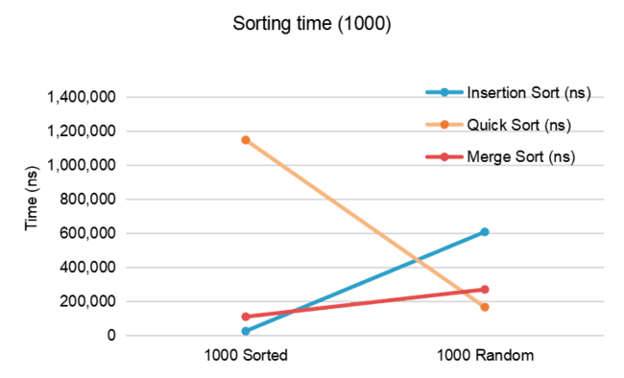
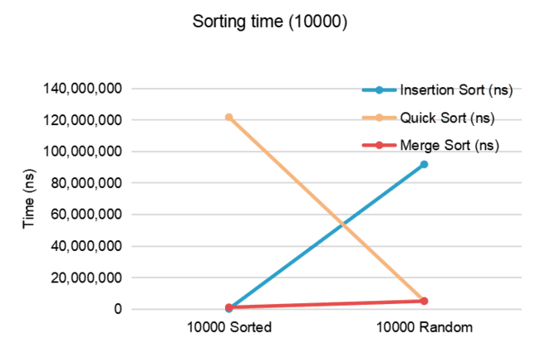
Performance results (Before Optimization)
Results (Before optimization)
Datasets | Insertion (ns) | Quick (ns) | Merge (ns)
1000places_sorted.csv | 25372 | 1147130 | 109962
1000places_random.csv | 607576 | 166384 | 270002
10000places_sorted.csv | 163882 | 121798278 | 1140158
10000places_random.csv | 91854396 | 5227834 | 5071162
Visualization
SORTING ALGORITHM
Notes:
Here are the results before we optimized Quick Sort.
As shown in the table, Quick Sort performed extremely poorly on sorted inputs, even worse than Insertion Sort.
In contrast, Merge Sort maintained consistent performance, and Insertion Sort was fast only on small, sorted data.

Slide 26
Quick Sort Pivot Optimization
Reason Analysis:
The first element serving as a pivot leads to performance degradation to O(n^2).
SORTING ALGORITHM
Notes:
This is because we used the first element as the pivot, which results in worst-case O(n²).

Slide 27
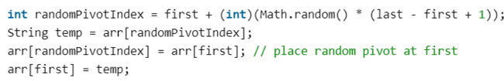
Quick Sort Pivot Optimization
Reason Analysis:
The first element serving as a pivot leads to performance degradation to O(n^2).
Solution:
Use a random pivot.
SORTING ALGORITHM
Notes:
To solve this problem, we introduced randomized pivot selection.
This balances the partitioning process and restores expected O(n log n) performance.

Slide 28
Quick Sort Pivot Optimization
Reason Analysis:
The first element serving as a pivot leads to performance degradation to O(n^2).
Solution:
Use a random pivot.
Result:
Datasets | Insertion (ns) | Quick (ns) | Merge (ns)
1000places_sorted.csv | 27456 | 157282 | 125046
1000places_random.csv | 849720 | 230492 | 193102
10000places_sorted.csv | 167580 | 1446840 | 1221380
10000places_random.csv | 58252036 | 2768646 | 2487356
SORTING ALGORITHM
Notes:
After optimization, Quick Sort became much faster on sorted input, reducing the execution time to around 2 million ns.

Slide 29
Algorithm Summary
Which sorting algorithm suits which dataset?
Insertion Sort
Best for small and sorted datasets (1000places_sorted.csv).
Not suitable for large or random datasets because of O(n²) time complexity.
Quick Sort (Optimized)
General sorting algorithm.
Performs well on both sorted and random datasets.
Unstable (many duplicates).
Merge Sort
Best for large datasets (including many duplicates).
Consistent performance on both sorted and random datasets.
Requires O(n) extra space complexity (low memory).
SORTING ALGORITHM
Notes:
To sum up
Insertion Sort is best for small and sorted datasets.
Quick Sort (with random pivot) is now suitable for general use, including large and random datasets.
Merge Sort is the most stable and consistent, especially suitable for large datasets with duplicates.
However, Merge Sort requires O(n) extra memory, so it may not be ideal in memory-constrained environments.

Slide 30
REFLECTION & FUTURE WORKS
Group 1

Slide 31
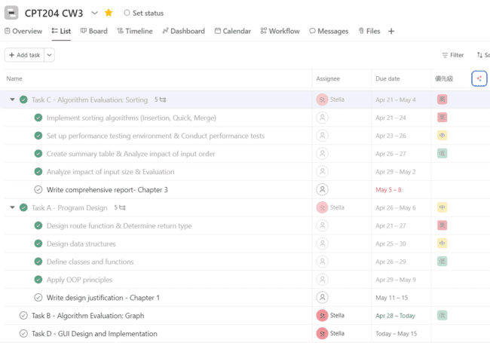
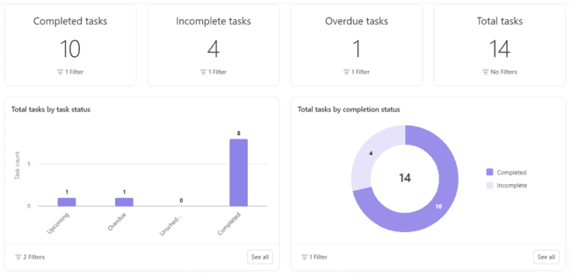
Planning & Teamwork
Planning:
We used Asana with AI tools for planning and task allocation. Tasks were broken down into subtasks with deadlines, and AI-assisted scheduling helped track progress dynamically.
REFLECTION & FUTURE WORKS

Slide 32
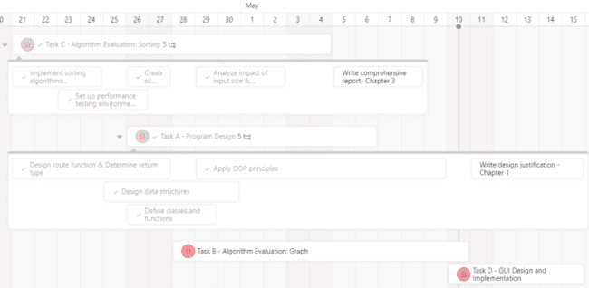
Planning & Teamwork
Planning:
We used Asana with AI tools for planning and task allocation. Tasks were broken down into subtasks with deadlines, and AI-assisted scheduling helped track progress dynamically.
Teamwork:
Each member contributed 50%. We shared responsibilities using modular design and collaborated through ChatGPT-generated meeting summaries and shared dashboards.
REFLECTION & FUTURE WORKS

Slide 33

Planning & Teamwork & EDI & Future Work
EDI（Equality, Diversity, Inclusion）:
🔹 Equality
Equal access to features; Fair error prompts; Balanced teamwork via AI
🔹 Diversity
Flexible city & attraction choice; Multiple algorithms; Modular & extensible
design
🔹 Inclusion
Clear color coding; Zoom, drag, hover support; Multi-select for attractions
REFLECTION & FUTURE WORKS

Slide 34
Planning & Teamwork & EDI & Future Work
EDI（Equality, Diversity, Inclusion）:
🔹 Equality
Equal access to features; Fair error prompts; Balanced teamwork via AI
🔹 Diversity
Flexible city & attraction choice; Multiple algorithms; Modular & extensible
design
🔹 Inclusion
Clear color coding; Zoom, drag, hover support; Multi-select for attractions
Future Work:
We'll optimize algorithm performance, remove redundant code, and improve visual feedback (e.g., color contrast). More inclusive design will support broader user needs.
REFLECTION & FUTURE WORKS

